Slide 1

Forage Virtual Data Science Internship
Web scraping to gain company insights
04/09/2023

Slide 2
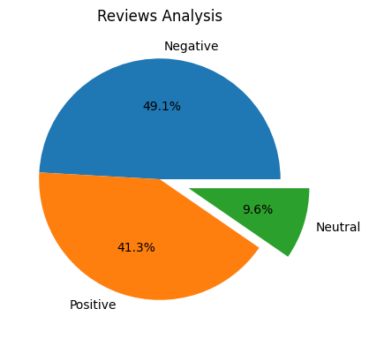
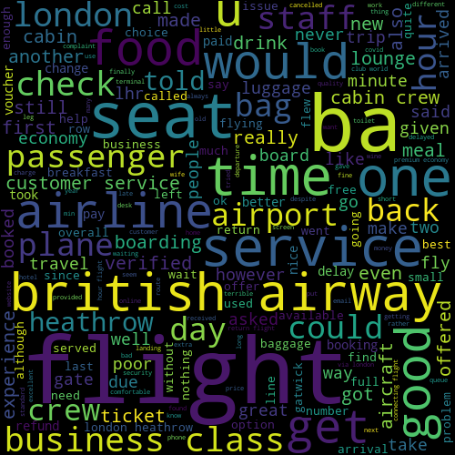
Collected and cleaned 3643 reviews given by customers, I obtained
Positive Reviews
1083
Negative Reviews
1505
Neutral Reviews
335

